Slide 1
Standalone Network for ABC Company Branch Office
Presented by: Anantharaman A Krishnan
Software used: Cisco Packet Tracer

Slide 2
Details of Projects
ABC is a fast growing organization in based in Alabama, with a global customer based exceeding customer base 2 million. The company focuses of buying and selling food items, operating primarily from its Headquarters. To expand its operations, The Company plans to open a new branch near a village of Bolzano. As the part of this ABC has requested to design and implement a standalone network for the Bolzano branch
The Branch Network will be a small scale and independent, designed to meet the following criteria
A . Network Devices: One router and one switch to be used
B. Departmental Segmentation: 3 Departments (Admin/IT, Finance/HR and Customer Service/Reception)
C. VLANs Management: Each department is required to be in different VLANs
D. Wireless Connectivity: Each department is required to have a wireless network for users
E. Interdepartmental Communications: Host devices in the network are required to obtain IPv4 address automatically
F. Test and Verifications: Devices in all departments are required to communicate with each other

Slide 3
Devices Used
SR No | Devices | Qty
1 | Router 2911 | 1
2 | Switch | 1
3 | PC | 3
4 | Printer | 3
5 | Access Point | 3
6 | Laptop | 3
7 | Smart Phone | 3
8 | Tablet | 2

Slide 4
Networking Commands Used
Sr No | Networking Commands
1 | Line vty
2 | SSH ( Transport )
3 | Vlan
4 | Switch port ( Access , Trunk )
5 | DHCP

Slide 5
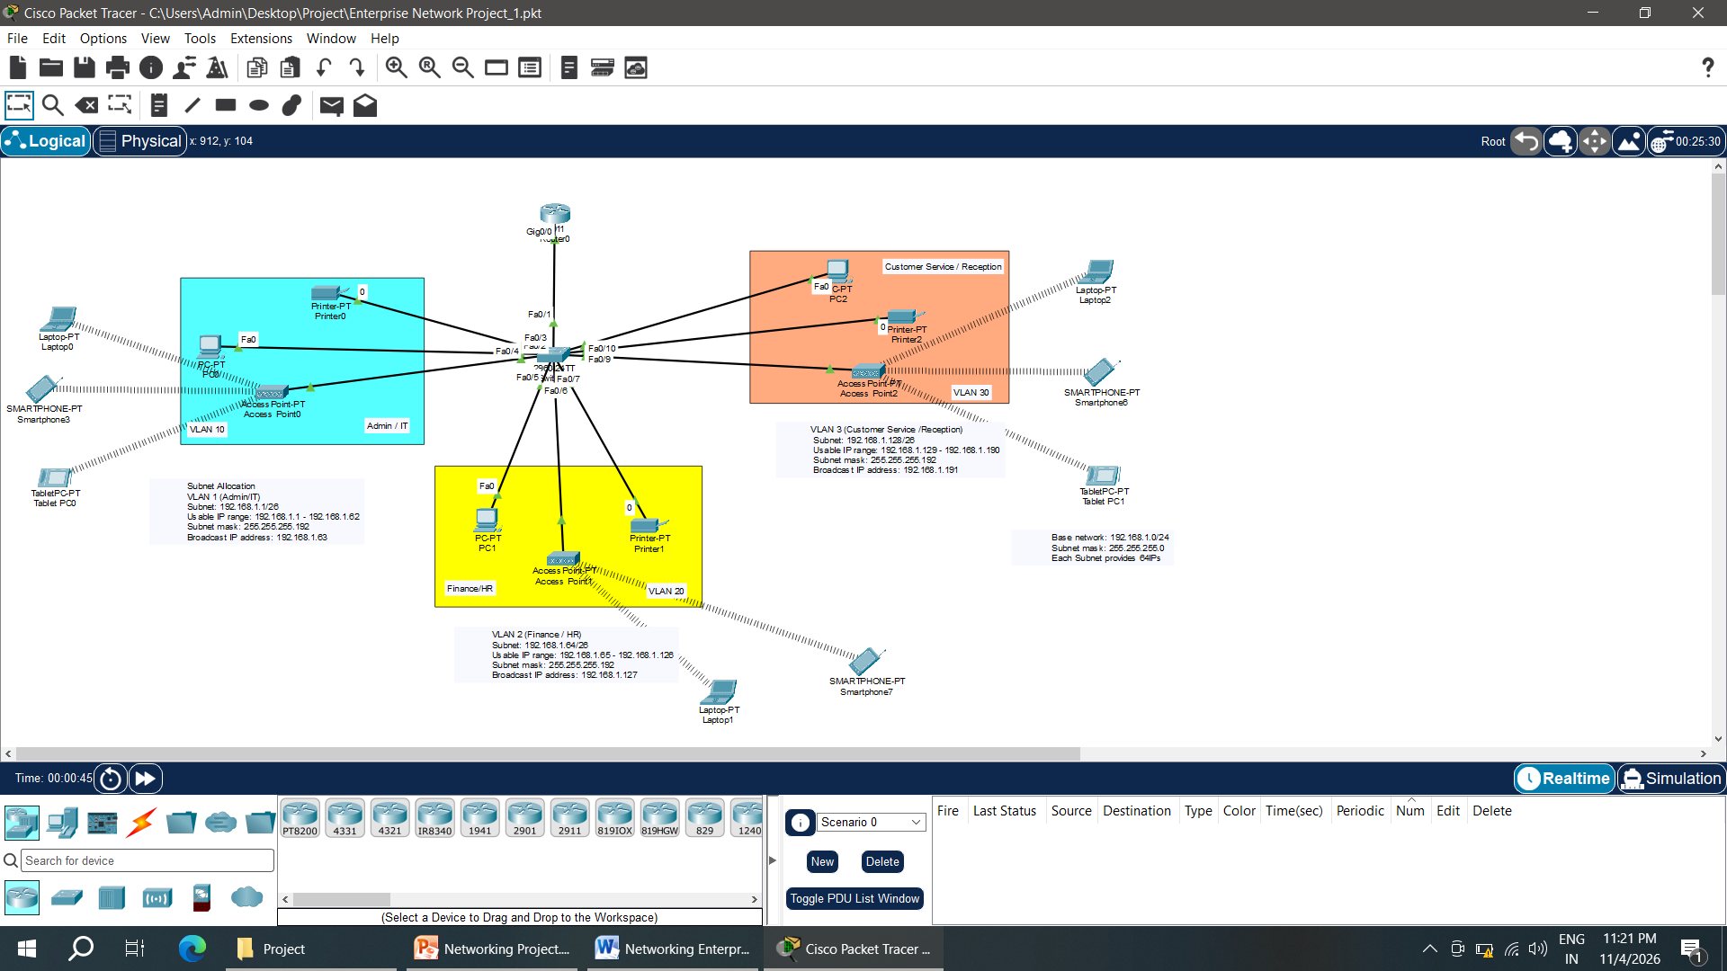
Star Topology with VLAN Segmentation

Slide 6
Network Allocations
Networking Commands
Base network: 192.168.1.0/24
Subnet mask: 255.255.255.0
Each Subnet provides 64IPs
Subnet Allocation
VLAN 1 (Admin/IT) | VLAN 2 (Finance / HR) | VLAN 3 (Customer Service /Reception)
Subnet: 192.168.1.1/26 | Subnet: 192.168.1.64/26 | Subnet: 192.168.1.128/26
Usable IP range: 192.168.1.1 - 192.168.1.62 | Usable IP range: 192.168.1.65 - 192.168.1.126 | Usable IP range: 192.168.1.129 - 192.168.1.190
Subnet mask: 255.255.255.192 | Subnet mask: 255.255.255.192 | Subnet mask: 255.255.255.192
Broadcast IP address: 192.168.1.63 | Broadcast IP address: 192.168.1.127 | Broadcast IP address: 192.168.1.191

Slide 7
Switch Configuration ( In details )
Configuration | Commands | Description
Switch(config)# | hostname HQ-SW
HQ-SW(config)# | banner motd #This is HQ switch. Unauthorized access is strictly prohibited#
HQ-SW(config)# | line console 0
HQ-SW(config-line)# | password cisco
HQ-SW(config-line)# | login
HQ-SW(config-line)# | exec-timeout 3 0
HQ-SW(config-line)# | logging synchronous
HQ-SW(config-line)# | exit
HQ-SW(config)# | enable password cisco
HQ-SW(config)# | line vty 0 15 | ( Tells a Cisco device to configure all 16 virtual terminal (VTY) lines—numbered 0 through 15 —which are used for remote access via telnet or SSH)
HQ-SW(config-line)# | password cisco
HQ-SW(config-line)# | login

Slide 8
Configuration | Commands | Description
HQ-SW(config-line)# | exit
HQ-SW(config)# | service password-encryption
HQ-SW(config)# | username cisco password cisco
HQ-SW(config)# | ip domain-name cisco.com
HQ-SW(config)# | crypto key generate rsa general-key modulus 1024 | The name for the keys will be: HQ-SW.cisco.com % The key modulus size is 1024 bits % Generating 1024 bit RSA keys, keys will be non-exportable...[OK] *Mar 1 0:22:18.444: %SSH-5-ENABLED: SSH 1.99 has been enabled The name for the keys will be: HQ-SW.cisco.com
HQ-SW(config)# | ip ssh version 2
HQ-SW(config)# | line vty 0 15
HQ-SW(config-line)# | login local
HQ-SW(config-line)# | transport input ssh
HQ-SW(config-line)# | exit
HQ-SW(config)# | access-list 1 permit 192.168.1.0 0.0.0.255
HQ-SW(config)# | access-list 1 deny any

Slide 9
Configuration | Commands | Description
HQ-SW(config)# | line vty 0 15
HQ-SW(config-line)# | access-class 1 in
HQ-SW(config-line)# | do wr | Building configuration… HQ-SW con0 is now available
Press RETURN to get started - Message displayed (This is HQ switch. Unauthorized access is strictly prohibited) you nee to enter the password to login in switch
HQ-SW(config)# | interface range fastEthernet 0/2-4 | global configuration command that lets you configure multiple interfaces at once
HQ-SW(config-if-range)# | switchport mode access | command configures a switch port to operate exclusively as an access port, carrying traffic for a single VLAN and disabling trunking
HQ-SW(config-if-range)# | exit
HQ-SW(config)# | vlan 10
HQ-SW(config-vlan)# | name admin
HQ-SW(config-vlan)# | vlan 20
HQ-SW(config-vlan)# | name hr
HQ-SW(config-vlan)# | vlan 30
HQ-SW(config-vlan)# | name cs

Slide 10
Configuration | Commands | Description
HQ-SW(config-vlan)# | exit
HQ-SW(config)# | interface range fastEthernet 0/2-4 | global configuration command that lets you configure multiple interfaces at once
HQ-SW(config-if-range)# | switchport mode access
HQ-SW(config-if-range)# | switchport access vlan 10
HQ-SW(config-if-range)# | interface range fastEthernet 0/5-7 | global configuration command that lets you configure multiple interfaces at once
HQ-SW(config-if-range)# | switchport mode access
HQ-SW(config-if-range)# | switchport access vlan 20
HQ-SW(config-if-range)# | interface range fastEthernet 0/8-10 | global configuration command that lets you configure multiple interfaces at once
HQ-SW(config-if-range)# | switchport mode access
HQ-SW(config-if-range)# | switchport access vlan 30
HQ-SW(config-if-range)# | exit
HQ-SW(config)# | fastEthernet 0/1
HQ-SW(config)# | switchport mode trunk | is a Cisco IOS interface‑configuration command that forces a switch port into permanent 802.1Q trunking mode, allowing it to carry multiple VLANs across a single link.
HQ-SW(config-line)# | do wr | Building configuration… HQ-SW is now configured

Slide 11
Router Configuration ( In detail )
Configuration | Commands | Description
Router(config)# | interface gig0/0
Router(config-if)# | no shutdown | %LINEPROTO-5-UPDOWN: Line protocol on Interface GigabitEthernet0/0, changed state to up
Router(config-if)# | exit
Router(config)# | interface gig0/0.10 | %LINEPROTO-5-UPDOWN: Line protocol on Interface GigabitEthernet0/0.10, changed state to up
Router(config-subif)# | encapsulation dot1Q 10
Router(config-subif)# | ip address 192.168.1.1 255.255.255.192
Router(config-subif)# | interface gig0/0.20 | %LINEPROTO-5-UPDOWN: Line protocol on Interface GigabitEthernet0/0.20, changed state to up
Router(config-subif)# | encapsulation dot1Q 20
Router(config-subif)# | ip address 192.168.1.65 255.255.255.192
Router(config-subif)# | interface gig0/0.30 | %LINEPROTO-5-UPDOWN: Line protocol on Interface GigabitEthernet0/0.30, changed state to up
Router(config-subif)# | encapsulation dot1Q 30
Router(config-subif)# | ip address 192.168.1.129 255.255.255.192

Slide 12
Configuration | Commands | Description
Router(config-subif)# | do wr | Building configuration
Router(config-subif)# | exit
Router(config)# | service dhcp
Router(config)# | ip dhcp pool admin
Router(dhcp-config)# | network 192.168.1.0 255.255.255.192
Router(dhcp-config)# | default-router 192.168.1.1
Router(dhcp-config)# | dns-server 192.168.1.1
Router(dhcp-config)# | exit
Router(config)# | ip dhcp pool hr
Router(dhcp-config)# | network 192.168.1.64 255.255.255.192
Router(dhcp-config)# | default-router 192.168.1.65
Router(dhcp-config)# | dns-server 192.168.1.65

Slide 13
Configuration | Commands | Description
Router(dhcp-config)# | exit
Router(config)# | ip dhcp pool CS
Router(dhcp-config)# | network 192.168.1.128 255.255.255.192
Router(dhcp-config)# | default-router 192.168.1.129
Router(dhcp-config)# | dns-server 192.168.1.129
Router(dhcp-config)# | do wr | Building configuration

Slide 14
DHCP IP Address after Router Configuration

Slide 15
Ping Status
Cisco Packet Tracer PC Command Line 1.0
C:\>ping 192.168.1.130
Pinging 192.168.1.130 with 32 bytes of data:
Request timed out.
Reply from 192.168.1.130: bytes=32 time=1ms TTL=127
Reply from 192.168.1.130: bytes=32 time=1ms TTL=127
Reply from 192.168.1.130: bytes=32 time<1ms TTL=127
Ping statistics for 192.168.1.130:
Packets: Sent = 4, Received = 3, Lost = 1 (25% loss),
Approximate round trip times in milli-seconds:
Minimum = 0ms, Maximum = 1ms, Average = 0ms
C:\>ping 192.168.1.66
Pinging 192.168.1.66 with 32 bytes of data:
Request timed out.
Reply from 192.168.1.66: bytes=32 time<1ms TTL=127
Reply from 192.168.1.66: bytes=32 time=1ms TTL=127
Reply from 192.168.1.66: bytes=32 time<1ms TTL=127
Ping statistics for 192.168.1.66:
Packets: Sent = 4, Received = 3, Lost = 1 (25% loss),
Approximate round trip times in milli-seconds:
Minimum = 0ms, Maximum = 1ms, Average = 0ms

Slide 16
We have successfully designed a standalone system for ABC Company as per their Requirement
Thank You……………

